Slide 1
Intelligent Classroom
Kashob Kumar Roy, 01
Syeed Abrar Zaoad, 23
Md. Tanvir Alam, 61

Slide 2
Outline
Overview
Motivation
Main Features
Task distribution

Slide 3
Overview
Classroom and education tools specially for computer science
Automation of teachers’, students’ and administration tasks
Online support for course management
Both web and android platform

Slide 4
Motivation
There is a huge amount of tasks in teaching as
Assignment Evaluation
Results
Notices
Class Routine Making
Attendance Tracking
To make these tasks easier, we plan to make the process as automated as possible. Our main focus is computer science education.

Slide 5
Main Features(1/2)
Algorithm visualization
Code Judge
Class Routine Making
Online Classroom
Online Quiz
Course Registration & Allocation
Result management

Slide 6
Main Features(2/2)
Teacher Registration
Student Registration
Student profile
Teacher profile
Student Attendance Update & Query
Thesis and project management.
Online notice board
Online helpline

Slide 7
Algorithm Visualization
Learning Algorithms from pseudocode is hard.
To make algorithm learning easy, simulation of algorithms can be helpful.
It is easier to teach algorithms with the help of simulation.
That is why we plan to make simulations for popular algorithms.
Users will be able to create the simulations for their own data.

Slide 8
Code Judge
Automatically evaluates a solution to a programming problem.
Teachers will provide input and corresponding output for the program.
Students will run their solution code to evaluate.
If the solution is correct, marks will be automatically added to student’s result.

Slide 9
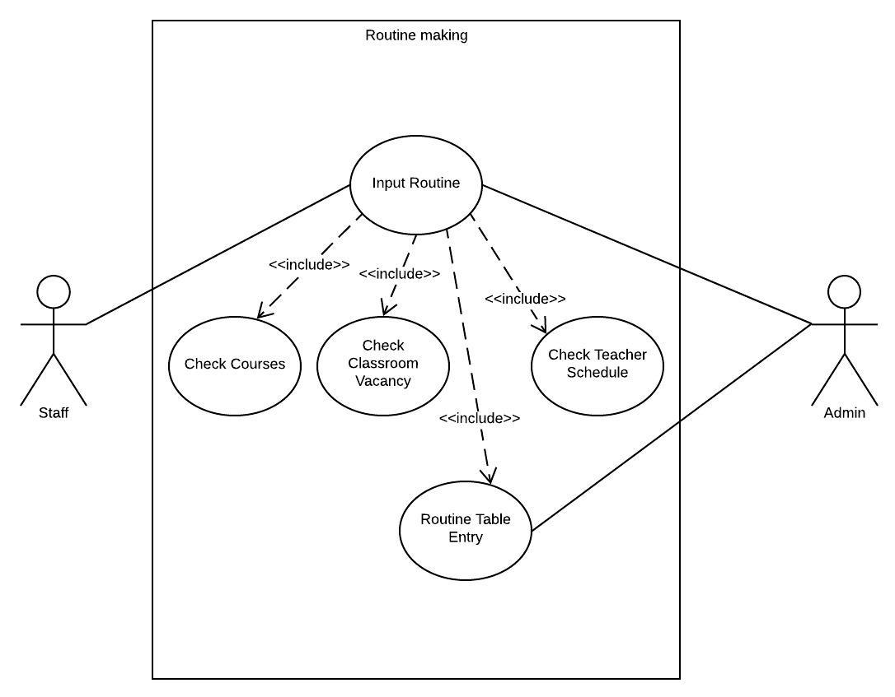
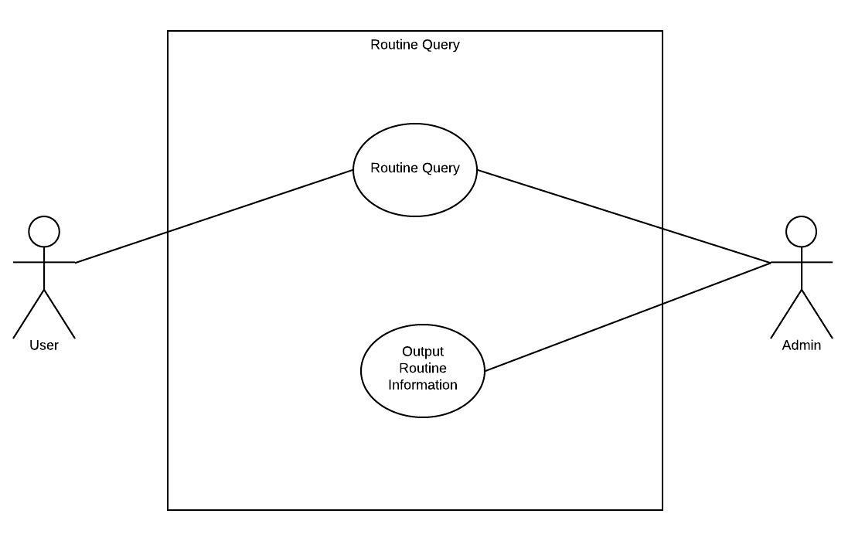
Class Routine Making & Query
Use CSP algorithm to make an automated routine making system
Student can easily find the routine for a particular course.

Slide 10
Online Classroom
An educational social platform
To share ideas and knowledges
To share files between teachers and students
To create , distributing and evaluating assignments
To suggest related articles

Slide 11
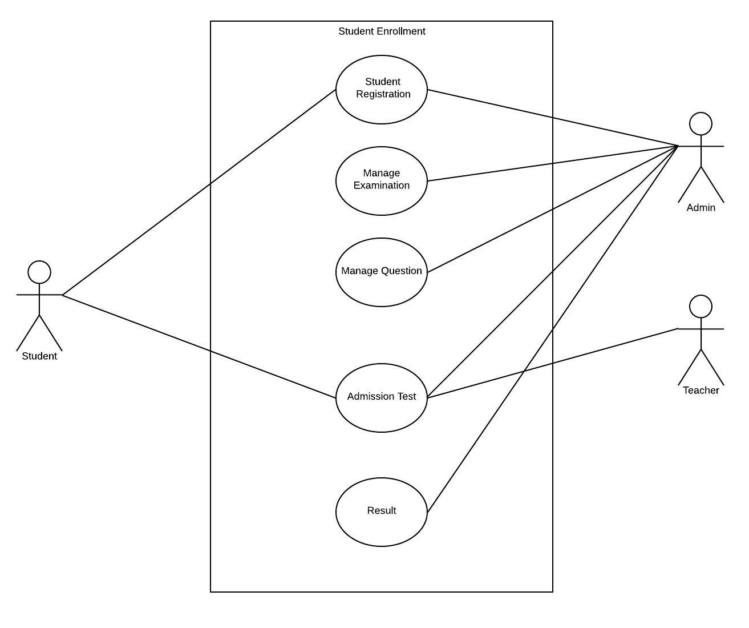
Student Registration
Admin can register the students based on their admission test performance.

Slide 12
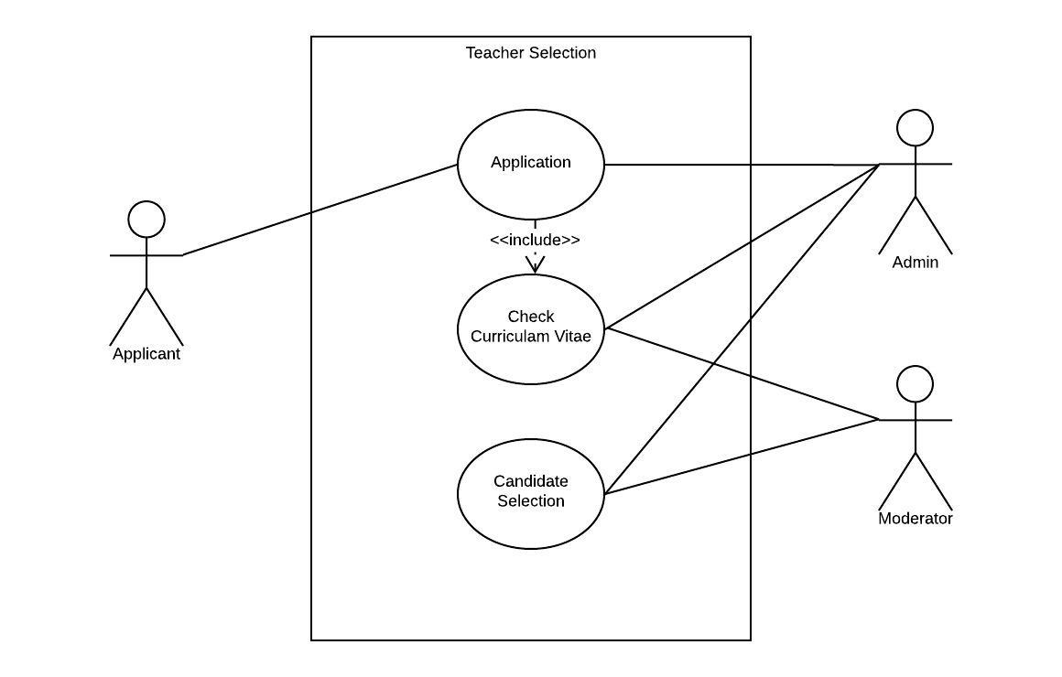
Teacher Registration
Admin can register a member as teacher
Teacher will have the permission to maintain a class and result.

Slide 13
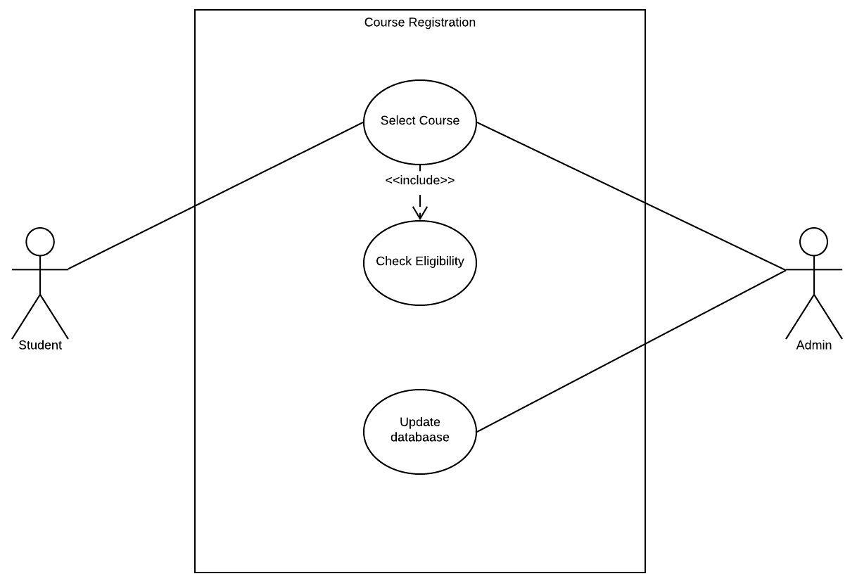
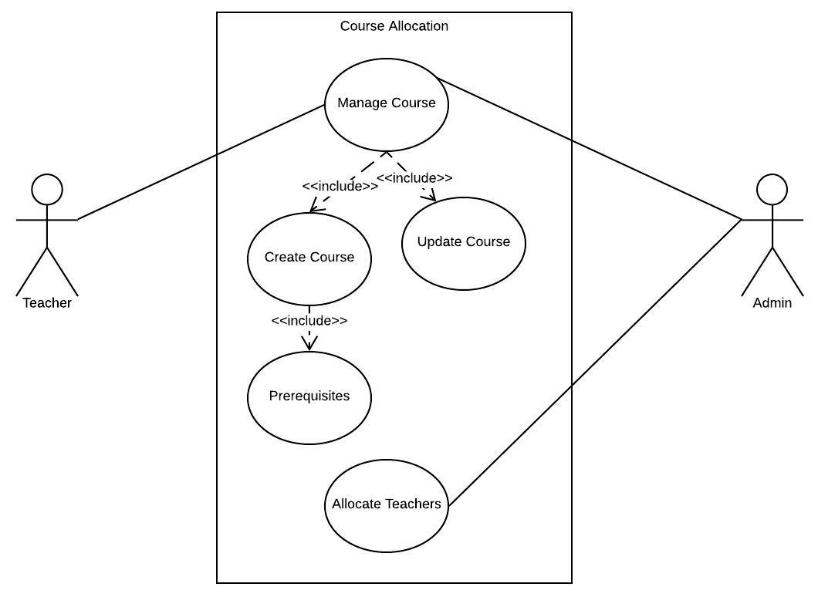
Course Registration & Allocation
Admin can register new courses
Course allocation among instructors

Slide 14
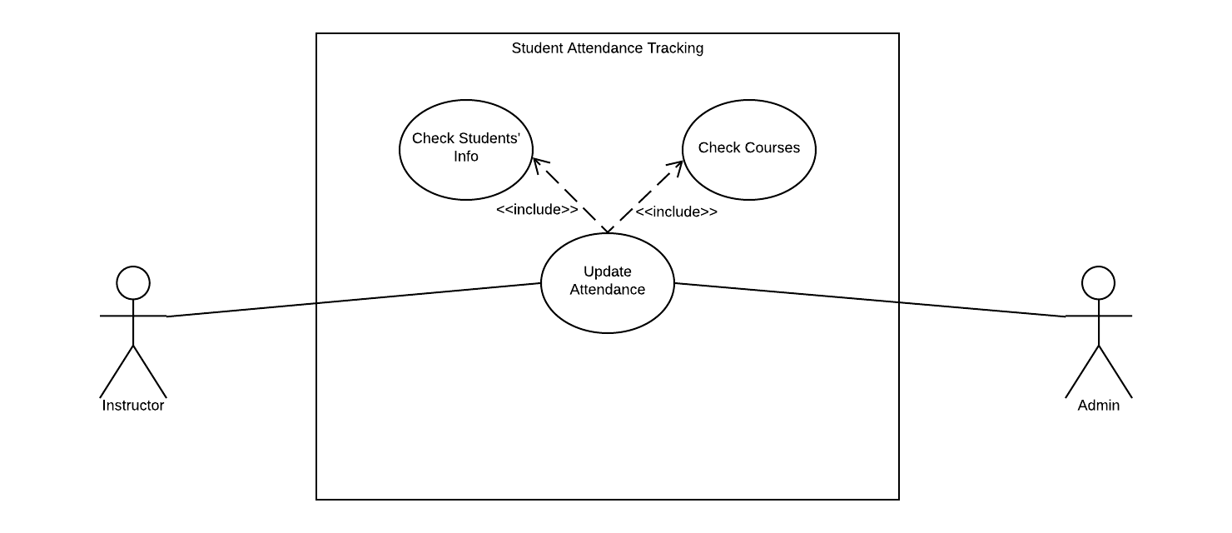
Student Attendance Update & Query
Teachers will update the attendance online in each class.
Attendance update will be visible to students concurrently.

Slide 15
Thesis and Project Management
Teacher will manage group of student for thesis
Teacher can give attachment and important resource to students
All work of the teacher listed there
Meeting time can fixed by our meeting time management system
Online Quiz
Teacher can generate quiz and add answer
Student can attend the quiz and see their mark , correct answer

Slide 16
Online Helpline
Any student and teacher can ask for any help.
All the members can reply with comment and attachment.
Members can promote any answer
Online Notice Board
All official notice and announcement are given there.
Admin can modify view access for teachers and student
All member can see the notices.

Slide 17
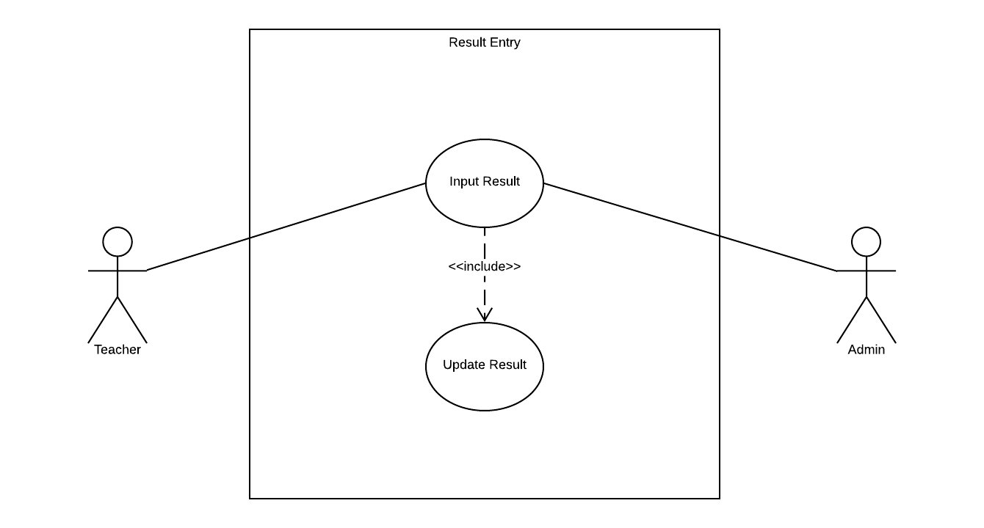
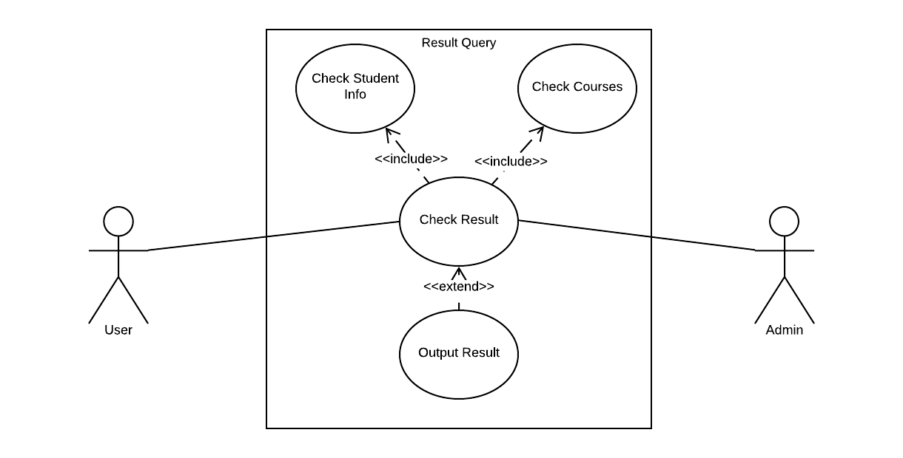
Result Management
Teachers will update their marks.
Grades will be calculated automatically.
Result will be updated automatically to student’s profile.
Users can query about student’s result.

Slide 18
Student and Alumni Profile
Contains academic result and project information
Contains current status and personal information
Contains publications and career information
Teacher Profile
Contains publications and career information
Contains previous course information
Contains field of interests

Slide 19
Task Distribution(1 / 3)
Online Classroom
Teacher Registration
Student Registration
Student profile
Teacher profile
Kashob Kumar Roy

Slide 20
Task Distribution(2 / 3)
Md. Tanvir Alam
Algorithm visualization
Class Routine Making & Query
Student Attendance Update & Query
Result management
Code Judge

Slide 21
Task Distribution(3 / 3)
Syeed Abrar Zaoad
Online Quiz
Online notice board
Course Registration & Allocation
Online helpline
Thesis and project management

Slide 22
Thank You

